Slide 2
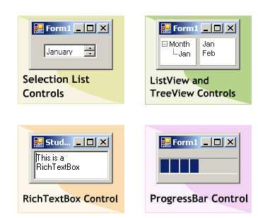
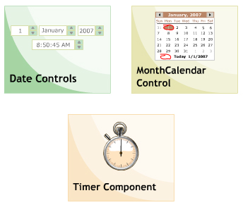
Objectives
SelectionList controls
ListView and TreeView control
RichTextBox control
ProgressBar control
Date controls
Timer component

Slide 3
Selection List Controls
Used for selecting a value from a specific range of values:
Values are selected by using up and down arrows.
Select only a single values of a time.
Two types :
NumericUpDown.
DomainUpDown.

Slide 4
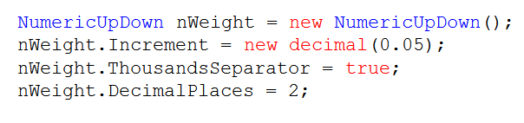

NumericUpDown
Property | Increment,Maximum,Minimum,Value DecimalPlaces ThousandsSeperator
Method | DownButton UpButton
Event | ValueChanged
Notes:
Increment : one of a series of increases:

Slide 5
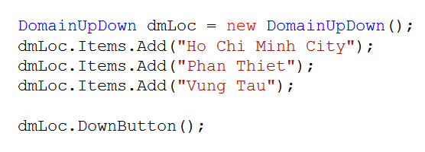

DomainUpDown
Property | Items, Wrap, ReadOnly SelectedItem, SelectedIndex
Method | DownButton, UpButton
Event | SelectedItemChanged
Notes:
Wrap : to cover or surround something with paper, cloth, or other material

Slide 6
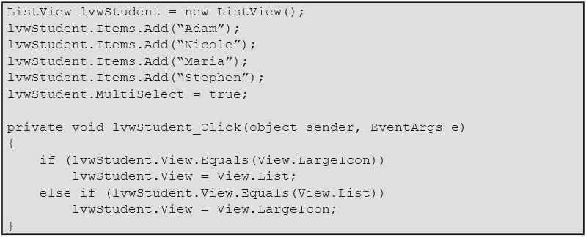
ListView
Used to display a collection of items in a list.
The ListView control is an ItemsControl that is derived from ListBox.
Types of ListView: Tile, List, Details, SmallIcon, LargeIcon.
Property | Columns, Items, View, MultiSelect, Sort, SelectedItems, SelectedIndices
Method | GetItemAt, Clear, ArrangeIcons
Event | ColumnClick, SelectedIndexChanged, ItemCheck, ItemSelectionChanged
Notes:
Columns : collection of column headers
View : view type

Slide 7
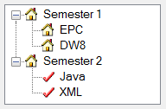
TreeView
Used for displaying data in
a hierarchical maner.
Has three types of nodes : Root, Parent and Leaf
Property | Nodes, TopNode, SelectedNode, ShowPlusMinus, ShowRootLines
Method | CollapseAll, ExpandAll, GetNodeAt, GetNodeCount
Event | NodeMouseClick, ItemDrag, AfterCollapse, AfterExpand, AfterSelect
Notes:
Hierarchical : arranged according to people's or things' level of importance, or relating to such a system

Slide 8
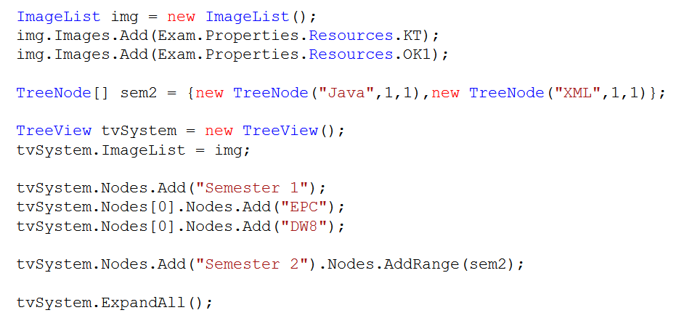

Slide 9
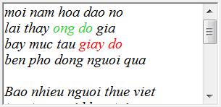
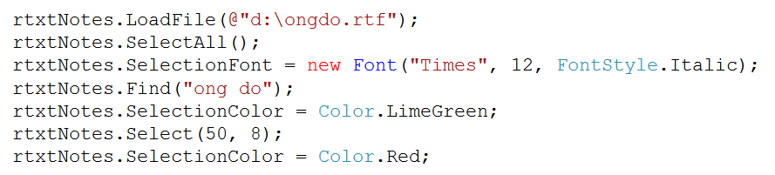
RichTextbox
Used for displaying, editing, manipulating text data similar Wordpad application
Also text and embedded image from files…
Property | Font, ScrollBars, SelectedText, SelectionFont, SelectionLength, Text, WordWrap
Method | AppendText, Copy, Paste, Redo, Undo
Event | Click, HScroll, Vscroll, SelectionChanged
Notes:
Manipulating : to control something or someone to your advantage, often unfairly or dishonestly

Slide 10
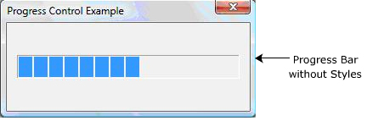
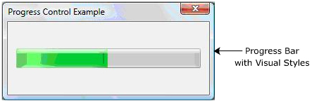
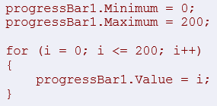
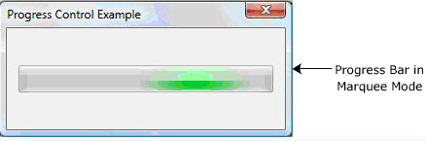
ProgressBar
Property | Method
Maximum Minimum Step Style Value | Increment, PerformStep

Slide 11
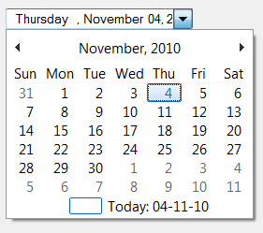

Date TimerPicker
Displays a graphical Calendar.
Allows user to select the desired date
Appears as a textbox along with a drop-down calendar.
Property | Format, MinDate, MaxDate, ShowCheckBox, Value, CustomFormat
Method | Focus, Show
Event | Click, FormatChanged, ValueChanged

Slide 12
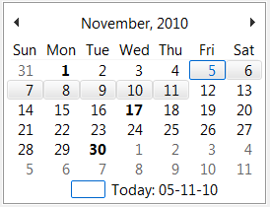
MonthCalendar
Allows selection of a range of dates
Can display multiple months
Cannot display time, not allow to type dates.
Property | CalendarDimensions, ShowToday, ShowTodayCircle, ShowWeekNumbers, TodayDate TitleBackColor, TitleForeColor, TrailingForeColor
Method | AddAnnuallyBoldedDate, AddMonthlyBoldedDate AddBoldedDate RemoveAnnuallyBoldedDate, RemoveMonthlyBoldedDate, RemoveBoldedDate, UpdateBoldedDate, SetDate
Event | Click, DateChanged, DateSelected

Slide 13
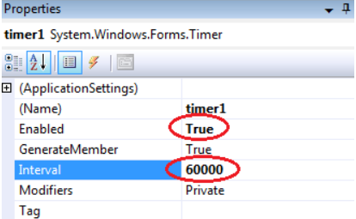

Timer
Generates an event at regular intervals. It is used to:
Setting an interval between two events.
Monitoring the time taken to complete a particular task.
Firing a particular action after a given time.
Limitation of Interval:
Less frequency, Short Interval
Inaccurracy, Inexact Precision
Property | Enable, Interval
Method | Start, Stop
Event | Tick

